Slide 1


Matoshri College of Engineering & Research Centre, Nashik
AI DEEPGUARD
DETECTION
AI-Based Deepfake Image Detection and Analysis System
Dept. of AI & Data Science Engineering | Guide: Dr. Ranjit M. Gawande | Team: Ruturani Maske, Gayatri Ahire, Kajal Kasar, Sakshi Salve

Slide 2
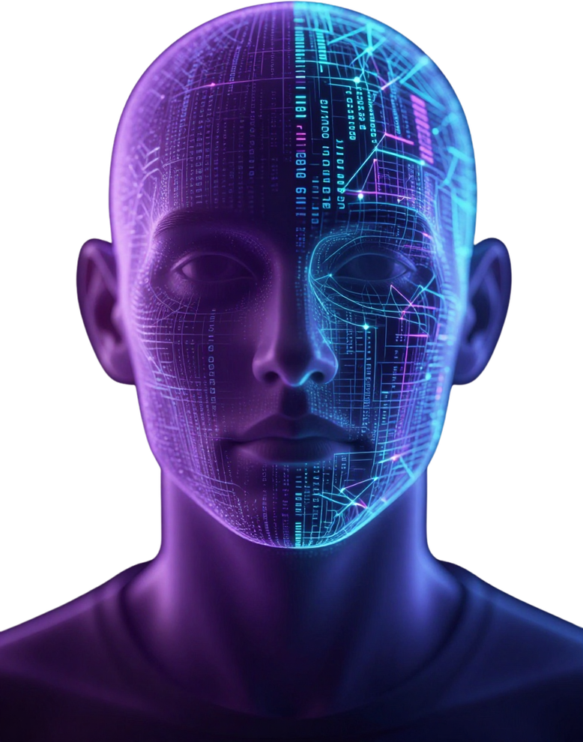
Introduction
Deepfake Technology & AI DeepGuard
Deepfake technology uses AI and deep learning to create or manipulate realistic facial images. Modern deepfakes are increasingly difficult to distinguish from genuine images through manual inspection, posing serious threats to digital identity, media authenticity, and online trust.
Digital Identity & Privacy
Media Authenticity
Misinformation Detection
Digital Security
AI DeepGuard: Deep Learning + Computer Vision + XAI
Matoshri College of Engineering & Research Centre, Nashik

Slide 3
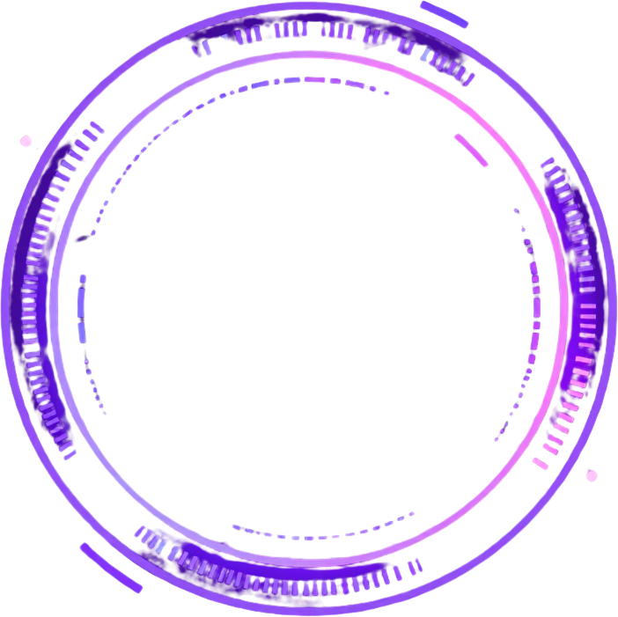
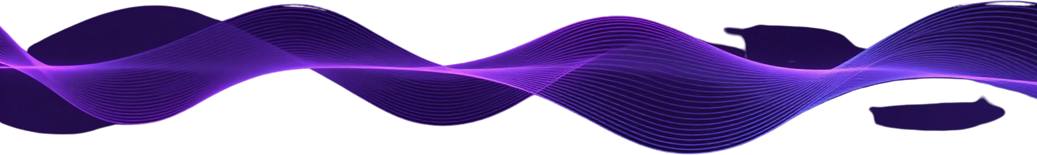
Problem
Statement
Deepfake facial images are increasingly realistic and difficult to identify through conventional methods. Existing tools lack user-friendly interfaces, offer predictions without sufficient explanation, and provide limited visualization of manipulated regions. There is no integrated solution for detection history, report generation, user authentication, or administrative management.
Proposed Solution Workflow:
Upload Image → Detect Face → Analyze Image → Predict Real/Fake → Generate Confidence Score → Explain Using Grad-CAM Heatmap → Store Result in Database → Generate Downloadable Report
AI DeepGuard addresses all identified gaps in a single integrated web-based platform.
Upload &
Detect Face
Analyze &
Predict
Confidence
& Heatmap
Store &
Report
AI DeepGuard Detection — Problem Statement

Slide 4
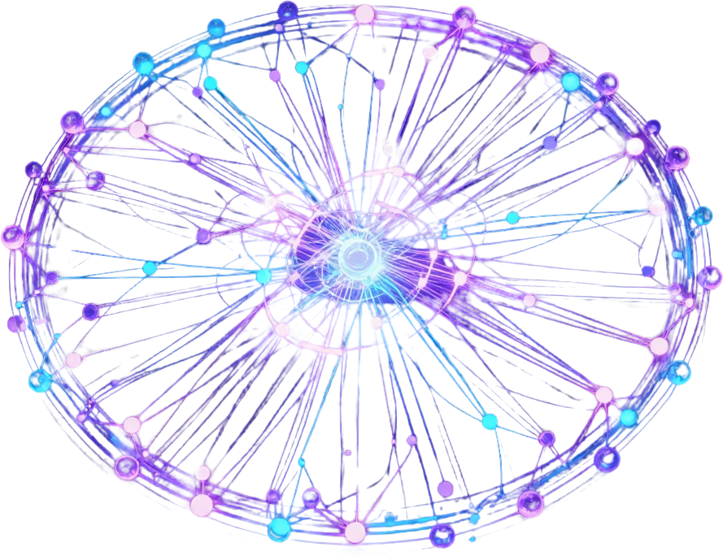
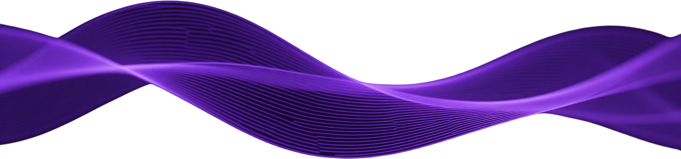
Project
Objectives
  AI-based deepfake image detection using deep learning models.
  Detect and extract facial regions from uploaded images.
  Perform Real / Fake classification of facial images.
  Generate a confidence score for each prediction result.
  Provide detailed deepfake analysis of manipulated regions.
  Implement Grad-CAM / Heatmap for visual explainability.
  Build an interactive result dashboard for users.
  Maintain detection history for all user sessions.
  Enable downloadable report generation from results.
Web Interface
Secure Login
Database Storage
Admin Dashboard
AI DeepGuard Detection — Matoshri College of Engineering, Nashik

Slide 5
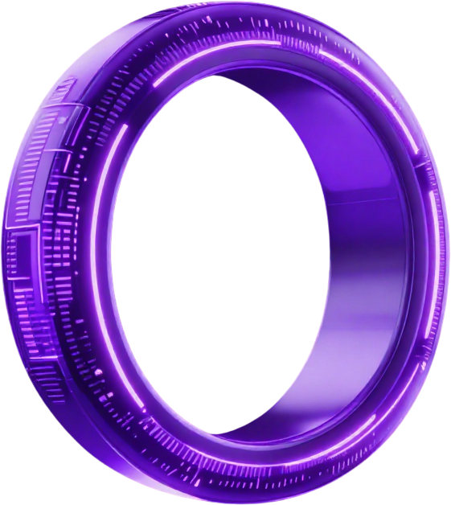
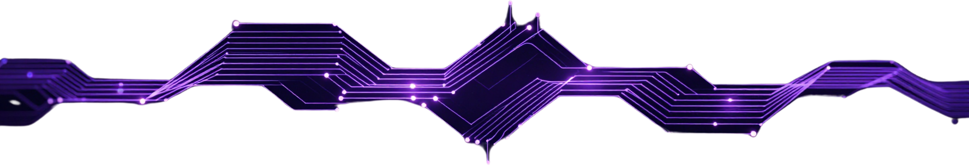
Literature
Survey
A review of recent deepfake detection research reveals significant advances in AI-based methods. The following works inform the design and scope of AI DeepGuard Detection, highlighting both progress and persistent research gaps in practical, explainable detection systems.
Research Gap: Existing models lack easy-to-use interfaces and provide predictions without sufficient explanation. Visualization of manipulated regions is limited, and most works present isolated models rather than complete applications with result management, history, and reporting.
Nguyen et al. — Localized Artifact Attention Network for Quality-Agnostic and Generalizable Deepfake Detection (CVPR 2024). Contribution: localized artifact attention for robust, generalizable deepfake detection across image qualities.
Huang et al. — Social Media Image Deepfake Detection, Localization and Explanation with Large Multimodal Model (CVPR 2025). Contribution: detection, manipulated-region localization, and natural language explanation.
[2024] LAA-Net
[2025] SIDA
[2026] BoVW-CNN
Alrahhal et al. — Deepfake Face Detection Using Hybrid Bag-of-Visual-Words and Multi-CNN Feature Fusion (Scientific Reports 2026). Contribution: handcrafted forensic features fused with deep CNN features for improved accuracy.
AI DeepGuard addresses all gaps: detection + confidence scoring + Grad-CAM explainability + interactive dashboard + detection history + PDF report generation + secure authentication.
Our Approach
AI DeepGuard Detection — Dept. of AI & Data Science | Matoshri College of Engineering

Slide 6




AI DeepGuard Detection
System Synopsis
A Flask-based web application integrating deep learning, computer vision and Explainable AI. The system processes facial images through a structured pipeline — from user input and AI analysis to result output and administrative management.
INPUT
AI ANALYSIS
OUTPUT
MANAGEMENT
User login, facial image upload, image validation and preprocessing pipeline.
Face detection, feature extraction, deep learning model, prediction, confidence score, Grad-CAM heatmap.
Result dashboard, prediction result, confidence score, visual explanation, detection history, report generation.
User authentication, database storage, admin dashboard and system administration.

Slide 7
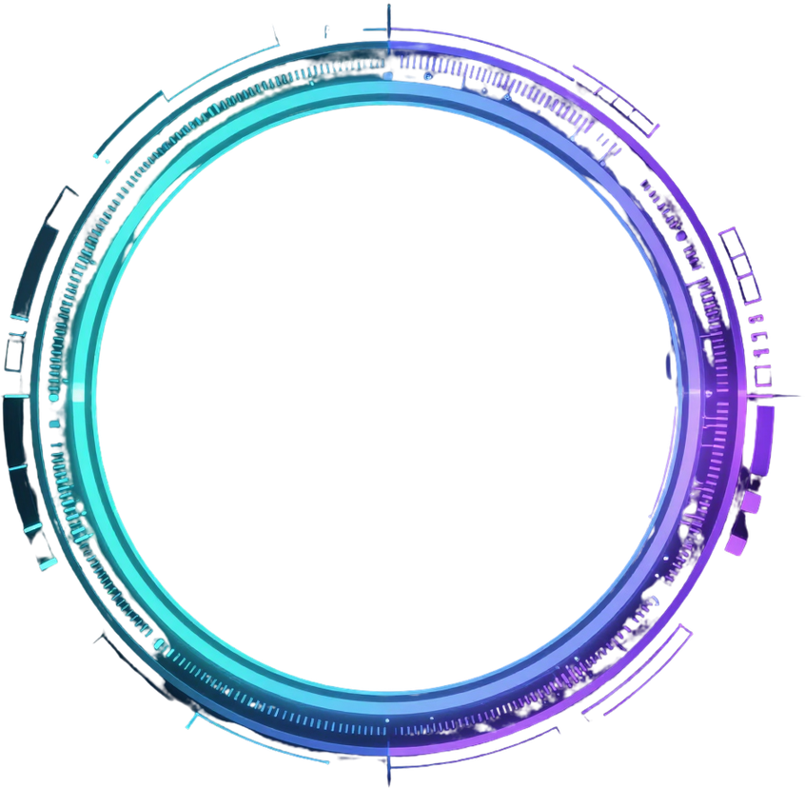
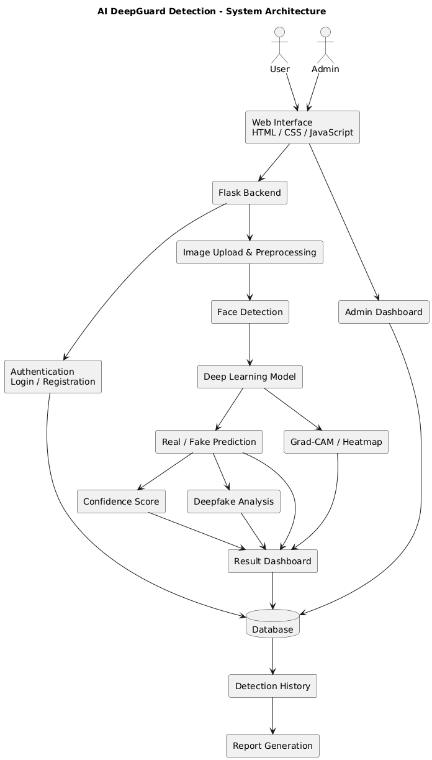
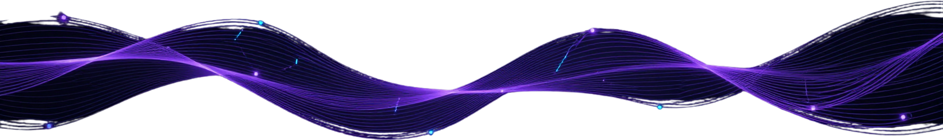
System
Architecture
Input & Web Interface Layer
Flask Backend & AI Model
Result Dashboard & XAI
Database & Admin Dashboard

Slide 8



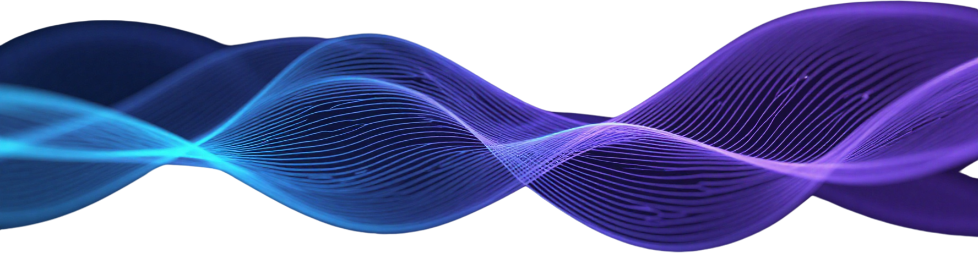
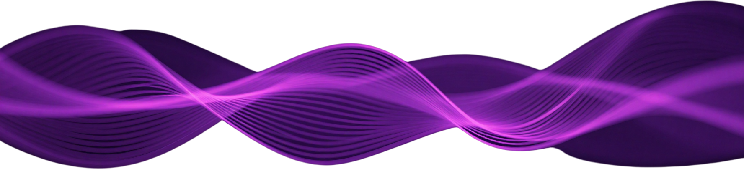


Methodology &
Expected Outcome
A structured six-step pipeline guides AI DeepGuard Detection — from raw data collection through deep learning inference, explainable AI visualization, and persistent result management — ensuring accurate, transparent, and accessible deepfake image detection.
Step 1: Data Collection
Step 2: Preprocessing
Step 3: DL Analysis
Step 4: Prediction
Step 5 & 6: XAI + Results
Collect genuine and deepfake-manipulated facial images from benchmark datasets. Ensure balanced class distribution for robust model training and evaluation.
Resize and normalize images. Detect and extract facial regions using face detection algorithms. Prepare standardized image tensors for model input.
Feed preprocessed facial images into the deep learning model. Extract high-level feature representations for classification using convolutional neural network layers.
Generate Real / Fake binary classification with associated confidence score. Provide deepfake analysis metrics for result interpretation.
Grad-CAM heatmap highlights influential image regions. Results displayed on dashboard, stored in database, added to history, and available for report generation.

Slide 9
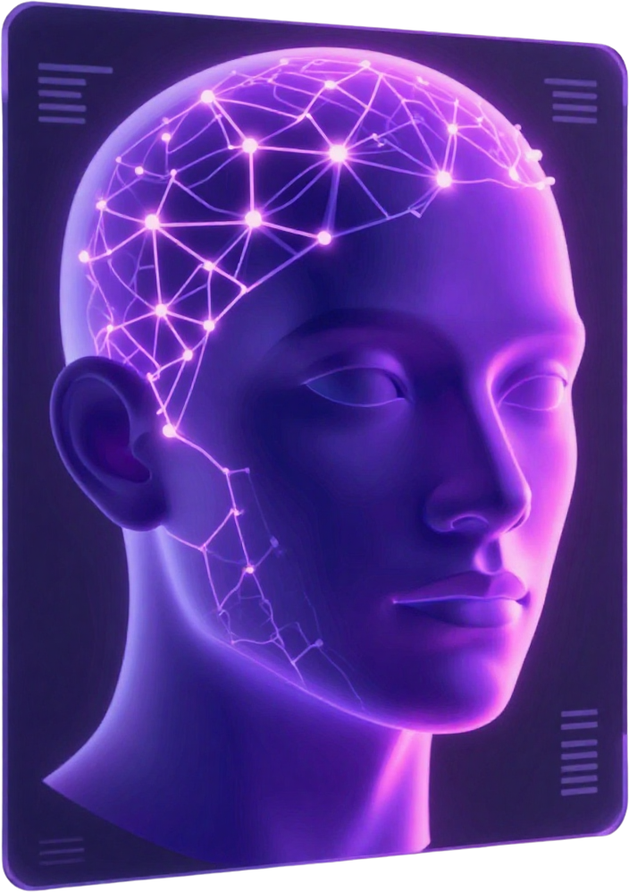
Expected
Outcomes
The AI DeepGuard Detection system delivers a comprehensive, web-based deepfake analysis platform combining deep learning, computer vision, and Explainable AI to provide accurate, transparent, and accessible facial image authenticity verification.
Automated Detection
Real/Fake Prediction
Heatmap Explanation
Report Generation
Secure User & Admin Management
AI DeepGuard Detection — Dept. of AI & Data Science | Matoshri College of Engineering

Slide 10

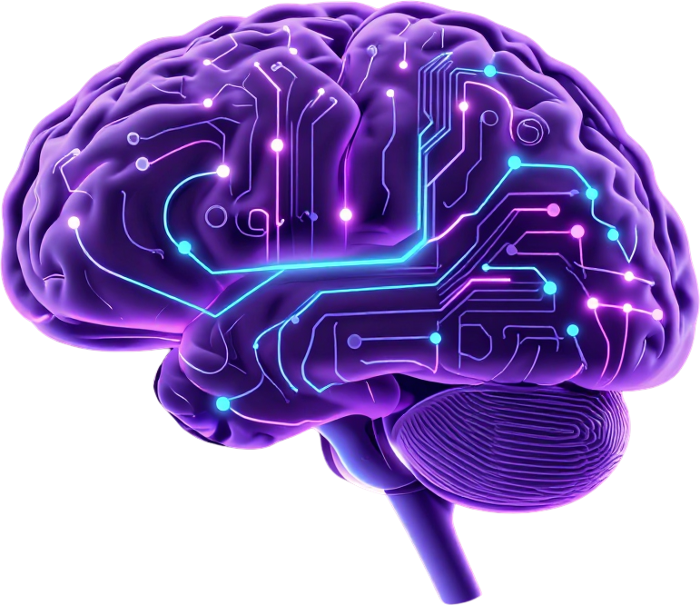
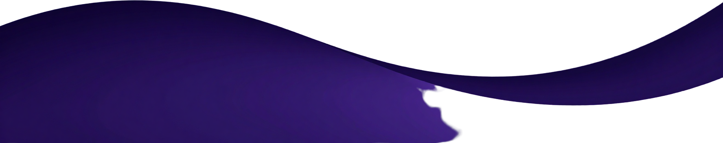
Conclusion
AI DeepGuard Detection System
An integrated approach combining Artificial Intelligence, Deep Learning, Computer Vision, and Explainable AI (XAI) for manipulated facial image detection.
Performs Face Detection, Real/Fake Classification, Confidence Scoring, Deepfake Analysis, and Grad-CAM / Heatmap Visualization
Platform provides User Authentication, Database Storage, Detection History, Result Dashboard, Report Generation, and Admin Dashboard
Makes deepfake detection accessible, understandable, and practical through a web interface
Future Scope:
Video deepfake detection • Real-time analysis • Improved detection of unseen manipulation techniques • Multimodal deepfake detection • Advanced forensic analysis
10 / 11

Slide 11
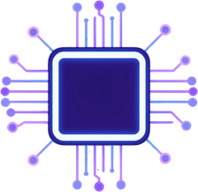
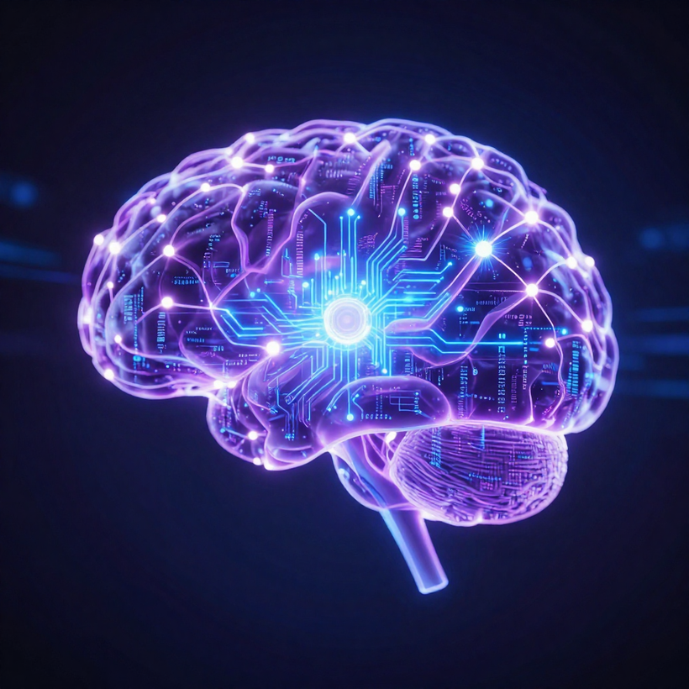
AI DeepGuard Detection
References
[1] D. Nguyen et al., “LAA-Net: Localized Artifact Attention Network for Quality-Agnostic and Generalizable Deepfake Detection,” Proceedings of the IEEE/CVF Conference on Computer Vision and Pattern Recognition (CVPR), 2024.
[2] Z. Huang et al., “SIDA: Social Media Image Deepfake Detection, Localization and Explanation with Large Multimodal Model,” Proceedings of the IEEE/CVF Conference on Computer Vision and Pattern Recognition (CVPR), 2025.
DOI: 10.1109/CVPR52734.2025.02685
[3] M. Alrahhal, F. Alqahtani, R. Latip, M. AlShabi, and W. M. Abd-Elhafiez, “Deepfake Face Detection Using Hybrid Bag-of-Visual-Words and Multi-CNN Feature Fusion,” Scientific Reports, 2026.
DOI: 10.1038/s41598-026-53464-w
Matoshri College of Engineering & Research Centre, Nashik

